Slide 1

Chapter 6: Abstraction Interface, and Encapsulation

Slide 2
Objectives
In this Chapter, you will learn：
Abstract class
Interface
Encapsulation

Slide 3
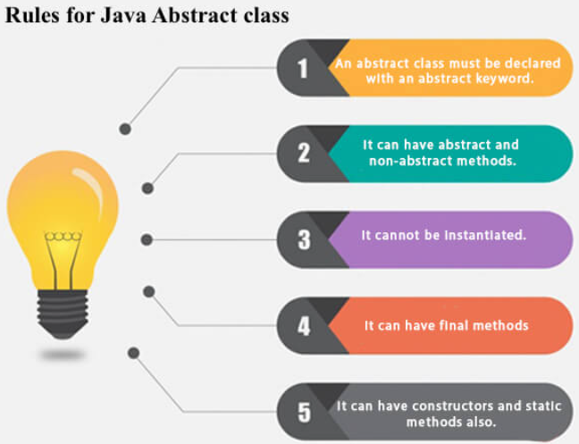
Abstract class
Abstraction is a process of hiding the implementation details and showing only functionality to the user.
Abstract class: can have abstract and non-abstract methods.
Abstract class needs to be extended and its method implemented.
Abstract class cannot be instantiated.
A class that is declared with the abstract keyword is known as an abstract class in Java.

Slide 4
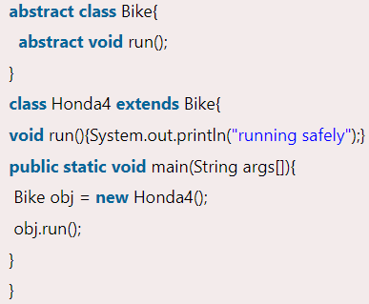
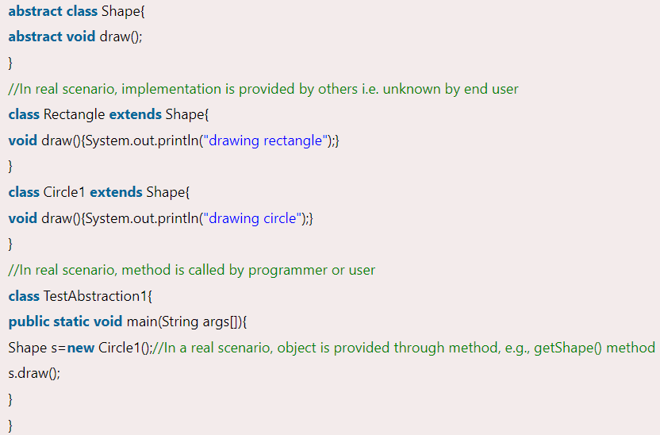
Abstract class
Example of Abstract class that has an abstract method
If there is an abstract method in a class, that class must be abstract. Hence the Bike 12 must be abstract.

Slide 5
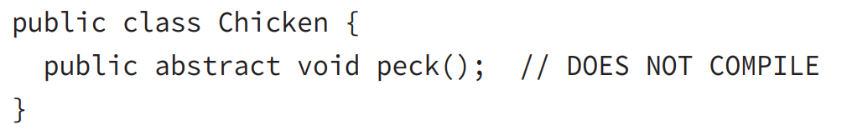

Abstract class
If there is an abstract method in a class, that class must be abstract.
An abstract class doesn’t have to implement any abstract methods

Slide 6
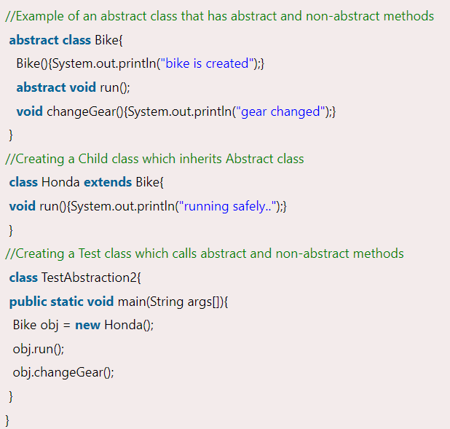
Abstract class

Slide 7
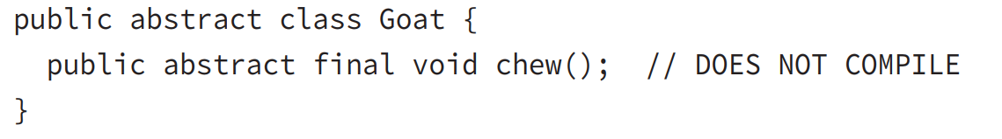
Abstract class
An abstract class cannot be marked as final.
By definition, an abstract class is one that must be extended by another class to
be instantiated, whereas a final class can’t be extended by another class.
An abstract method may not be marked as final for the same reason that an abstract class may not be marked as final

Slide 8
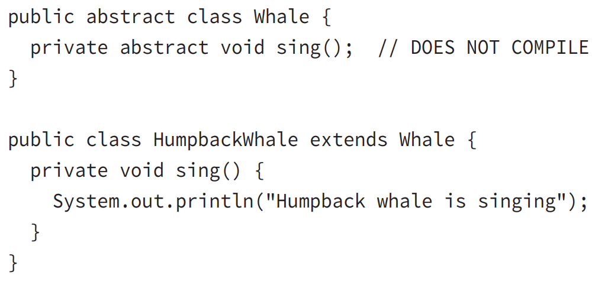
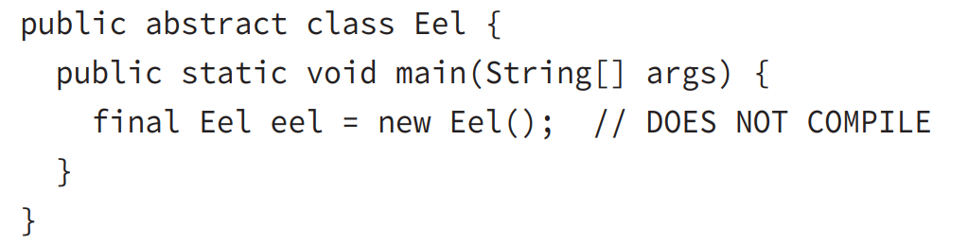
Abstract class
A method may not be marked as both abstract and private
How would you define a subclass that implements a required method if the method is not accessible by the subclass itself? The answer is you can’t, then:
Abstract class cannot be instantiated

Slide 9
Abstract class
Abstract Class Definition Rules:
Abstract classes cannot be instantiated directly.
2. Abstract classes may be defined with any number, including zero, of abstract and nonabstract methods.
3. Abstract classes may not be marked as private or final.
4. An abstract class that extends another abstract class inherits all of its abstract methods as its own abstract methods.
5. The first concrete class that extends an abstract class must provide an implementation
for all of the inherited abstract methods.

Slide 10
Abstract class
Abstract Method Definition Rules:
Abstract methods may only be defined in abstract classes.
2. Abstract methods may not be declared private or final.
3. Abstract methods must not provide a method body/implementation in the abstract
class for which is it declared.
4. Implementing an abstract method in a subclass follows the same rules for overriding a
method.
For example, the name and signature must be the same, and the visibility of
the method in the subclass must be at least as accessible as the method in the parent
class.

Slide 11
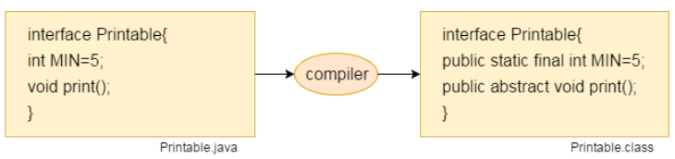
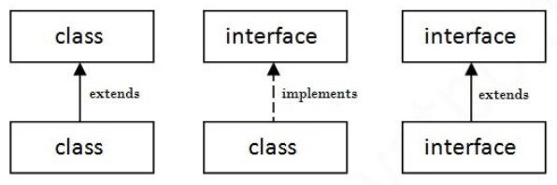
Interface in Java
Interface in Java is defined as an abstract type used to specify the behavior of a class.
A Java interface contains static constants and abstract methods.
A class can implement multiple interfaces.
Interfaces are declared using the interface keyword.
All methods in the interface are implicitly public and abstract.
A Java interface contains static constants and abstract methods.
A class that implements an interface must implement all the methods declared in the interface.
All the methods in an interface are declared with the empty body, and all the fields are public, static, and final by default.
Relationship between classes and interfaces

Slide 12
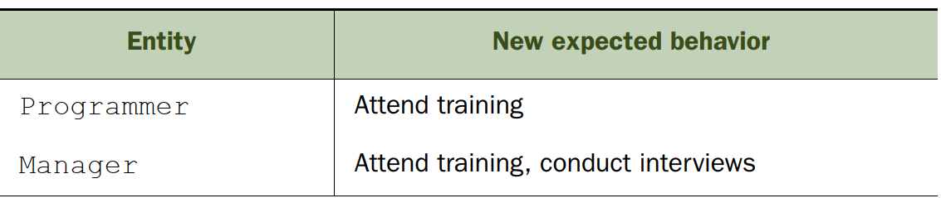
Interface in Java
Need for using interfaces
You need interfaces to enable multiple classes to support a set of behaviors. Let’s work
with the example of Employee class in chap Inheritance, where Eployee is the base class and
classes Programmer and Manager subclass Employee.
Imagine that your boss steps in and states that Programmer and Manager must support additional behaviors, as follows:
How will you accomplish this task?
One approach you can take is to define all the relevant methods in the class Employee. Because both Programmer and Manager extend the class Employee, they’d be able to access these methods.
But : Programmer doesn’t need the behavior of the conducting interview task; only Manager should support the functionality of conducting interviews.

Slide 13
Interface in Java
Need for using interfaces
You need interfaces to enable multiple classes to support a set of behaviors. Let’s work
with the example of Employee class in chap Inheritance, where Eployee is the base class and
classes Programmer and Manager subclass Employee.
Imagine that your boss steps in and states that Programmer and Manager must support additional behaviors, as follows:
How will you accomplish this task?
One approach you can take is to define all the relevant methods in the class Employee. Because both Programmer and Manager extend the class Employee, they’d be able to access these methods.
But : Programmer doesn’t need the behavior of the conducting interview task; only Manager should support the functionality of conducting interviews.

Slide 14
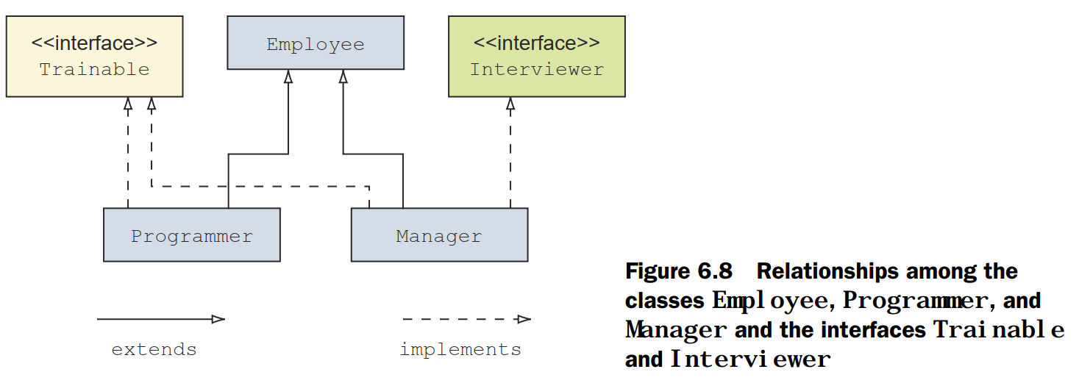
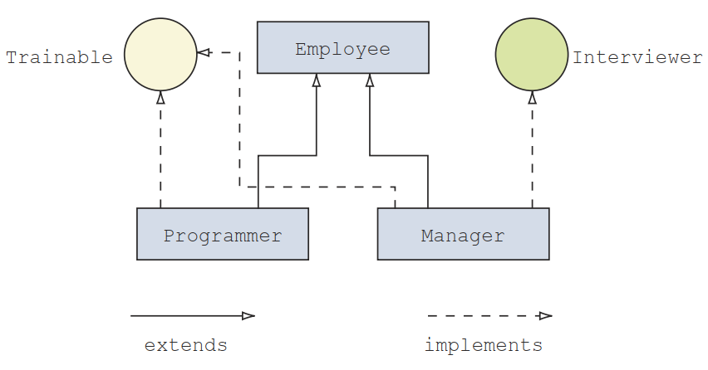
Interface in Java
Solution: Java allows a class to implement multiple interfaces. A class uses the keyword implements to implement an interface.

Slide 15
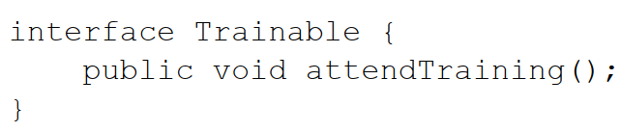
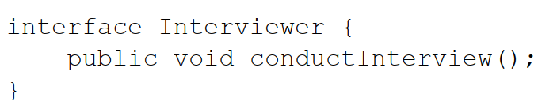
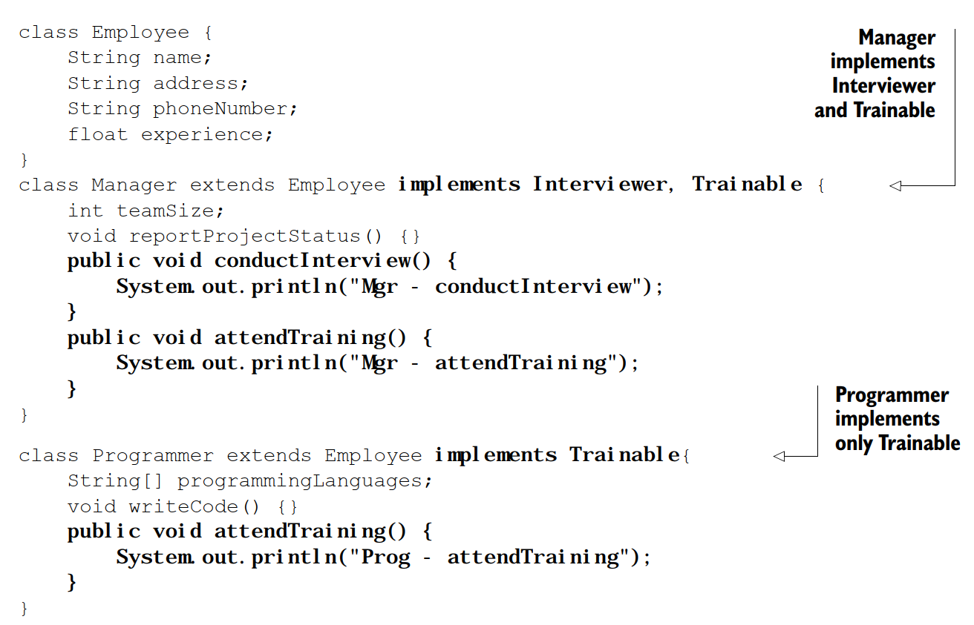
Interface in Java
Solution: Java allows a class to implement multiple interfaces. A class uses the keyword implements to implement an interface.

Slide 16
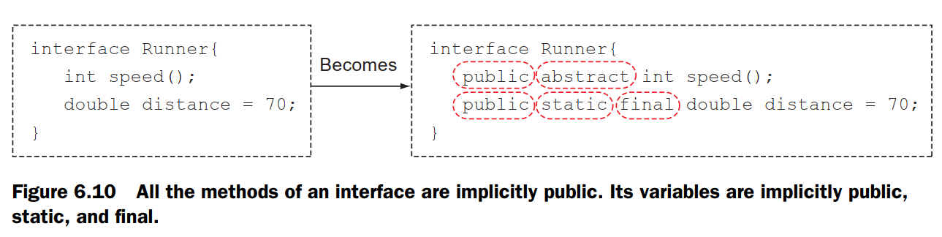
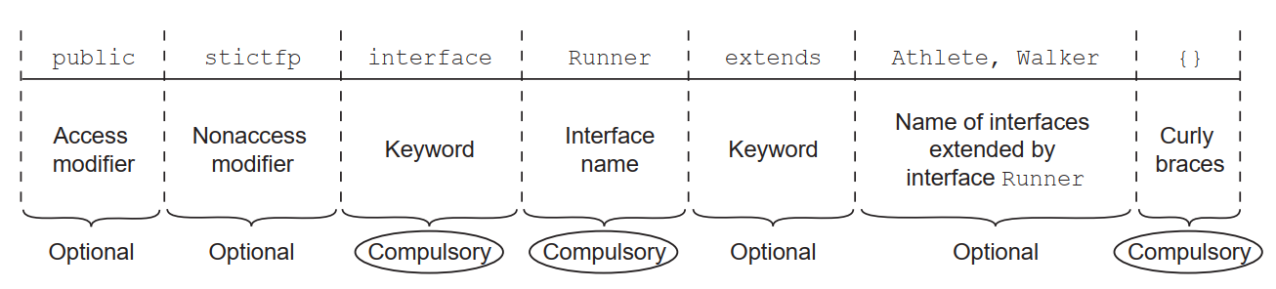
Interface in Java
Rules
All methods of an interface are implicitly public.
The interface variables are implicitly public, static, and final
Components of an interface declaration
Example: public strictfp interface Runner extends Athlete, Walker {}

Slide 17
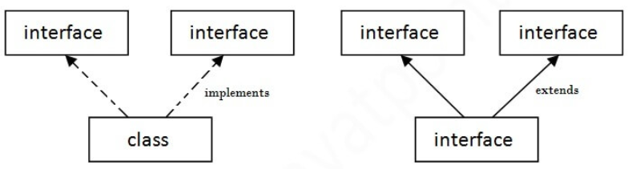
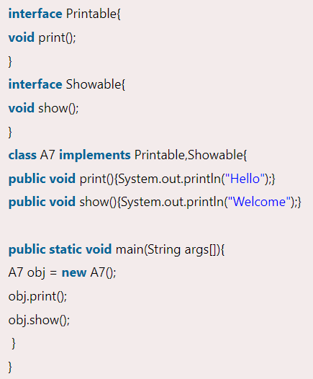
Interface in Java
When to use Interface and Abstract Class?
Use an abstract class when a template needs to be defined for a group of subclasses.
Use an interface when a role needs to be defined for other classes, regardless of the inheritance tree of these classes
Multiple inheritance in Java by interface
interface is used to achieve total abstraction to solve the issue with multiple inheritance

Slide 18
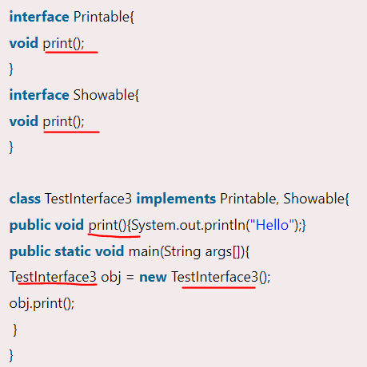
Interface in Java
Quick Question:
1) Why Multiple inheritance is not supported through class, but it is possible by an interface,
This is because Interface implementation is provided by the implementation class
Printable and Showable interface have same methods but its implementation is provided by class TestTnterface1, so there is no ambiguity.

Slide 19
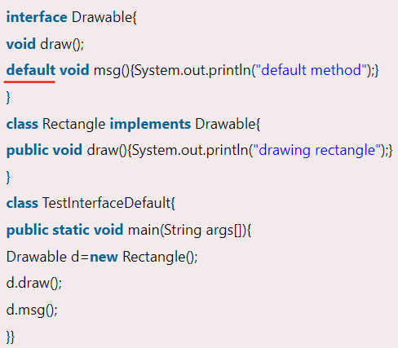
Interface in Java
Java 8 Default Method in Interface: Since Java 8, we can have a method body in the interface. But we need to make it default method
Since Java 8, we can have static methods in interface

Slide 20


Interface in Java
Types of methods in an interface
Oracle has made fundamental changes to interfaces in Java 8. Apart from abstract methods, an interface can define methods with default implementations. It can also define static methods. Here’s a quick list of the types of methods that can be defined in an interface (in Java 8):
■ abstract methods
■ Default methods (new in Java 8)
■ static methods (new in Java 8)
Note: Interface methods are implicitly abstract. To define default or static methods, you must explicitly use the keyword default or static with the method declaration in an interface. Default and static methods include their implementation in an interface.

Slide 21
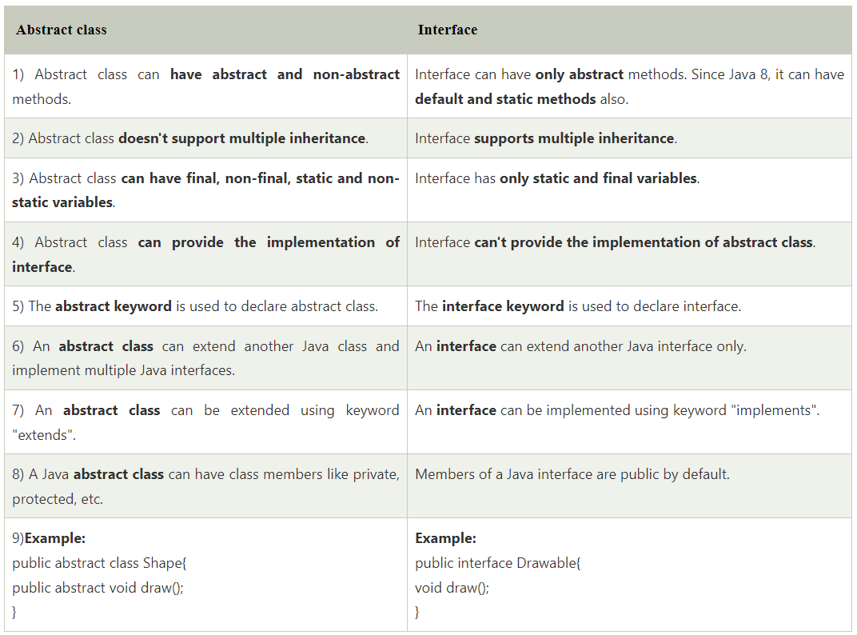
Difference between Abstract Class and Interface

Slide 22
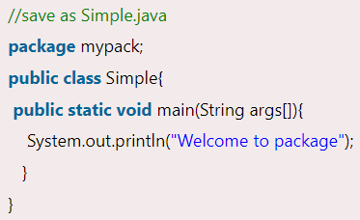


Java Package
A java package is a group of similar types of classes, interfaces and sub-packages.
Advantages of Java Package
1) Used to categorize the classes and interfaces so that they can be easily maintained.
2) Provides access protection.
3) Removes naming collision.
If you are not using any IDE, you need to follow the syntax given below:
javac -d directory javafilename
How to access package from another package?
import package.*;
import package.classname;
fully qualified name.

Slide 23
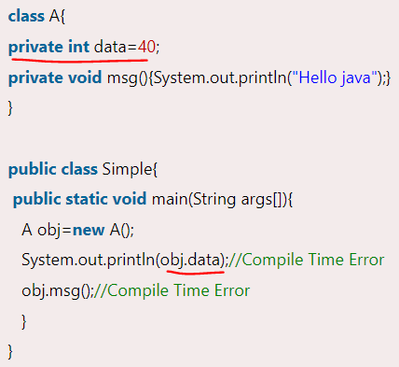
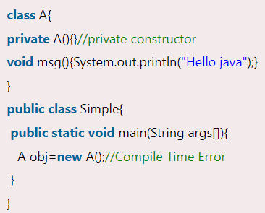
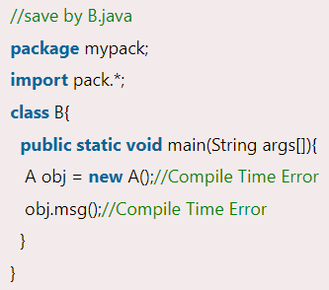
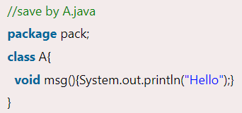
Access Modifier
The scope of class A and its method msg() is default so it cannot be accessed from outside the package

Slide 24
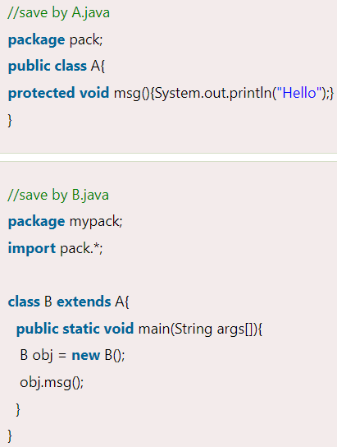
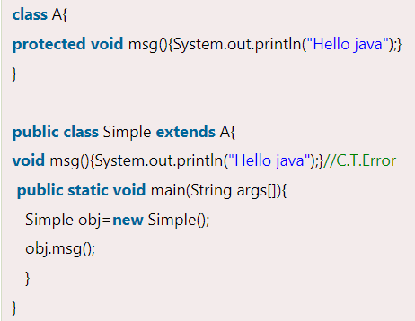
Access Modifier
The protected access modifier is accessible within the package and outside the package but through inheritance only.
protected access modifier can be applied to the data member, method, and constructor.
Protected can't be applied to the class.

Slide 25
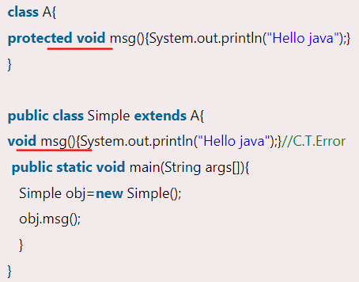
Access Modifier
default modifier is more restrictive than protected.

Slide 26

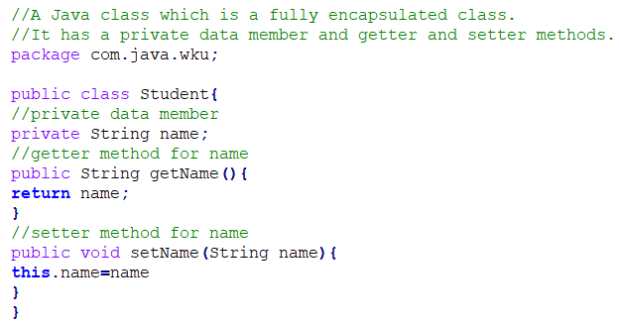
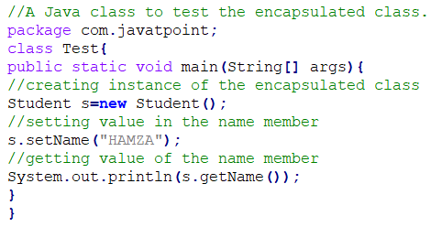
Encapsulation in Java
default modifier is more restrictive than protected.
Encapsulation in Java is a process of wrapping code and data together into a single unit.
We can create a fully encapsulated class in Java by making all the data members of the class private.
We can use setter and getter methods to set and get the data in it.

Slide 27
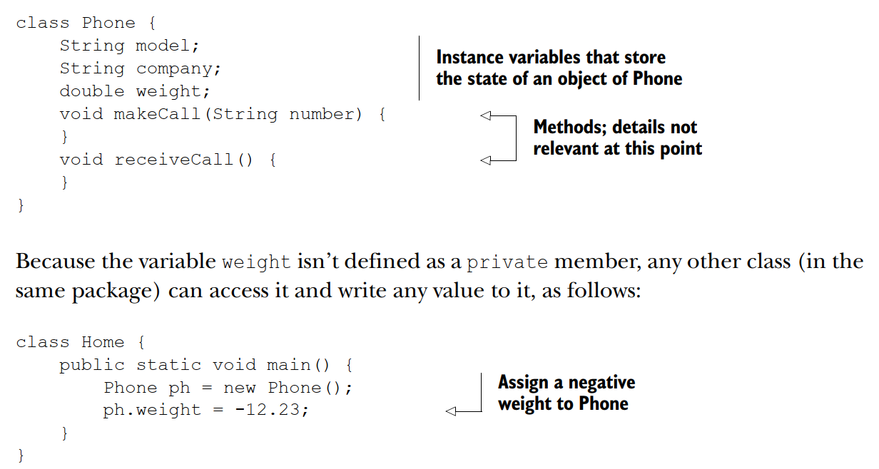
Encapsulation in Java
Reasons to encapsulate the state of a Java object:
■ To prevent an external object from performing dangerous operations
■ To hide implementation details, so that the implementation can change a second time without impacting other objects
Example without Encapsulation

Slide 28
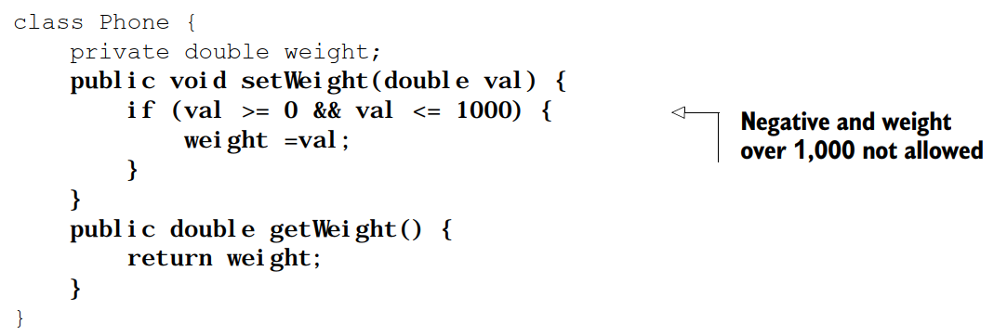
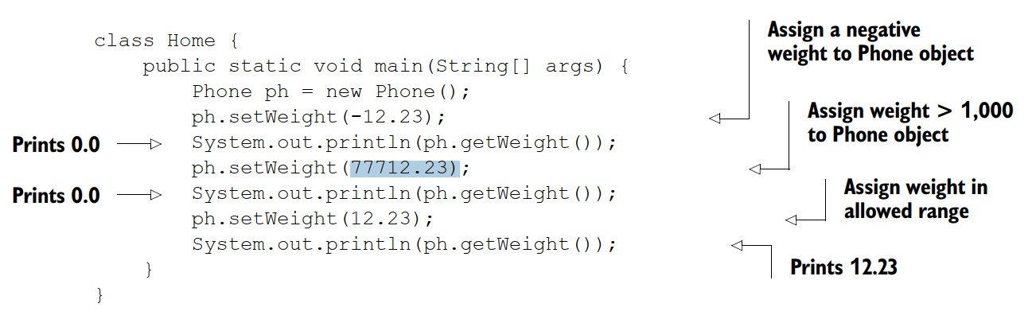
Encapsulation in Java
Example with Encapsulation

Slide 29
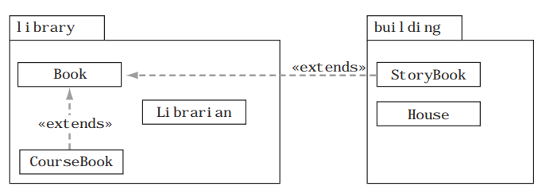
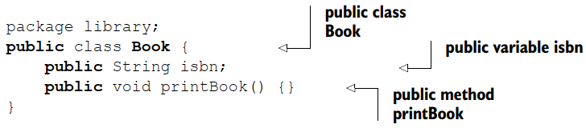
Understand Java Access Modifiers
3) Understand Java Access Modifiers
Let’s Consider the following Classes: Book, Librarian, CourseBook (defined in the package library), StoryBook, and House (defined in the package building)
StoryBook and House are defined in separate packages
A) public access modifier

Slide 30
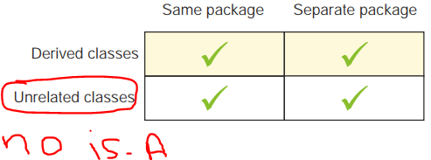
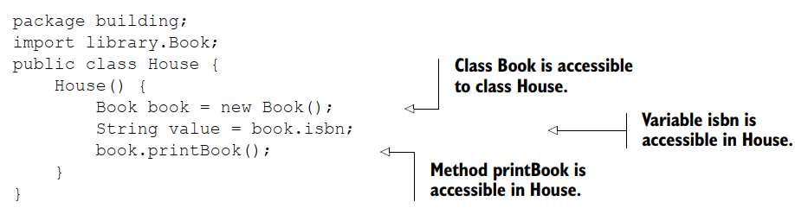
Understand Java Access Modifiers

Slide 31

Understand Java Access Modifiers
A) Public access modifier: the members of a class defined using access modifier are accessible to:
Class and interfaces are defined in the same package.
All sub-classes, even if they are defined in separate packages.

Slide 32
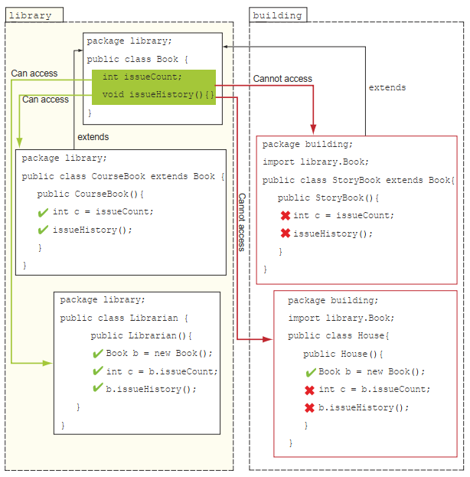
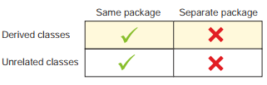
Understand Java Access Modifiers
B) defaut access modifier: the members of a class defined using any explicit access modifier are defined with package accessibility (also called package-private):
Accessibility: Class and interfaces are defined in the same package

Slide 33
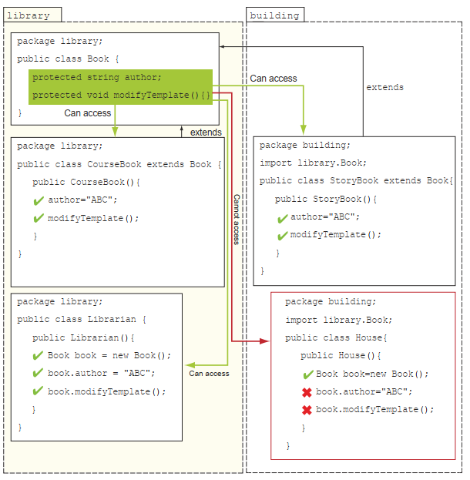
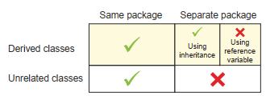
Understand Java Access Modifiers
C) protected access modifier: the members of a class defined using access modifier are accessible to:
Class and interfaces are defined in the same package.
All sub-classes, even if they are defined in separate packages.
Classes that can access protected members

Slide 34
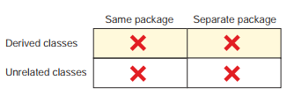
Understand Java Access Modifiers
D) private access modifier: accessible only in the same class

Slide 35
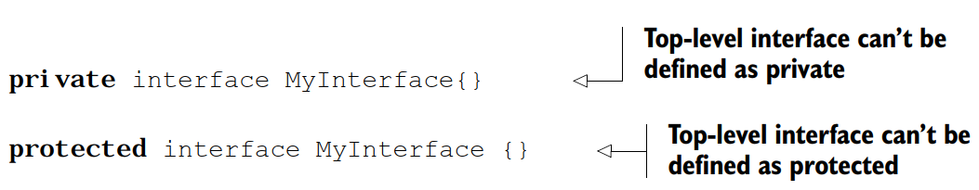
VALID ACCESS MODIFIERS FOR AN INTERFACE
You can declare a top-level interface (the one that isn’t declared within any other class or interface), with only the following access levels:
■ public
■ No modifier (default access)

Slide 36
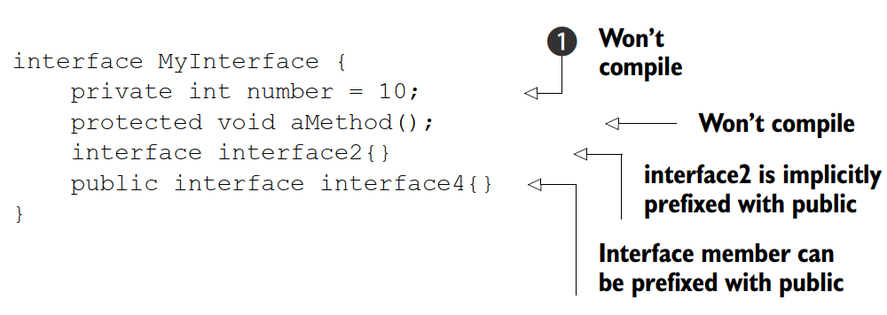
VALID ACCESS MODIFIERS FOR MEMBERS OF AN INTERFACE
All members of an interface—variables, methods, inner interfaces, and inner classes
(yes, an interface can define a class within it!)—are inherently public because that’s
the only modifier they can accept.

Slide 37
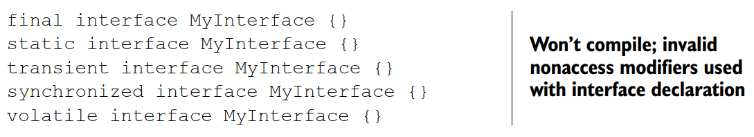
VALID NONACCESS MODIFIERS FOR AN INTERFACE
You can declare a top-level interface with only the following nonaccess modifiers:
■ abstract
■ strictfp
NOTE: The strictfp keyword guarantees that results of all floating-point calculations are identical on all platforms.

